Slide 1
Amazon Q Business
GTech

Slide 2
Agenda
Introduction to Amazon Q Business
Key Features of Amazon Q Business
How Amazon Q Business Works
Data Sources and Connectors
Plugins and Business Actions
Identity, Access, and Security
Administrative Controls and guardrails
Amazon Q Apps and Productivity
Real-World Example
Benefit, Limitations, and Best Practices
Conclusion

Slide 3
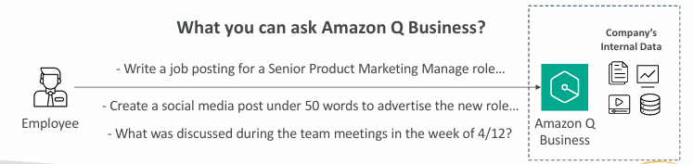
Introduction to Amazon Q Business
Fully managed generative AI assistant for employees.
Uses an organization’s business knowledge and information.
Answers questions and summarizes internal documents.
Helps create content, such as reports and job descriptions.
Can support routine tasks through configured plugins.
Built on Amazon Bedrock, with the underlying foundation model managed by AWS

Slide 4
Key Features of Amazon Q Business
Natural-language question answering.
Summarization of company documents and information.
Content generation, including emails and reports.
Responses with source citations to help verify information.
Integration with supported business applications.
Personalized responses based on relevant user and organizational context.

Slide 5
How Amazon Q Business Works
Connects to approved organizational data sources.
Ingests and indexes supported information for retrieval.
Receives questions from authenticated employees.
Retrieves relevant information from connected data.
Uses generative AI to formulate a response.
Provides source references where supported.

Slide 6
Data Sources and Connectors
Managed connectors link supported business data sources.
Examples include Amazon S3, SharePoint, and Microsoft 365.
Other supported sources include Salesforce and Slack.
Connectors help bring information into an index from retrieval.
Source permissions can be reflected in employee access.
Administrators configure and maintain data connections.

Slide 7
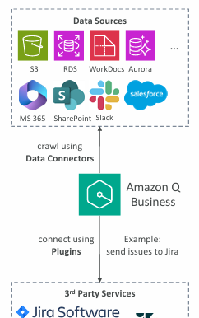
Plugins and Business Actions
Plugins connect Amazon Q Business to supported external services.
They can enable actions, not just information retrieval.
Examples include creating Jira issues or scheduling meetings.
Built-in and custom plugins are available.
Custom plugins can integrate with supported third-party APIs.
Actions require appropriate configuration, permissions, and authorization.

Slide 8
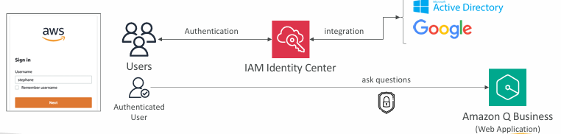
Identity, Access, and Security
Supports user authentication and access management.
Integrates with AWS IAM Identity Center.
Can integrate with supported external identity providers.
Responses are based on information users are permitted to access.
Data-source permissions must be configured correctly.
Administrators should review roles, policies, and credentials.

Slide 9

Administrative Controls and Guardrails
Configure how the assistant responds to employees.
Set blocked topics and organizational restrictions.
Control which knowledge sources can inform responses.
Customize response style, tone, and length.
Use permissions and policies to limit access.
Test the assistant for accuracy, safety, and appropriate behavior.

Slide 10
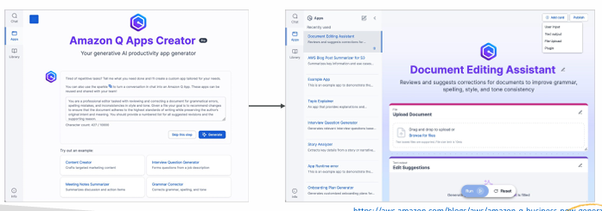
Amazon Q Business and Productivity
Q Apps support creation of purpose-built AI applications.
Users can describe an app using natural-language instructions.
Apps can help standardize recurring business tasks.
Q Apps can use organizational data and configured plugins.
Sharing and access can be managed within the organization.
Availability depends on the configured features and subscription.

Slide 11
Real-World Example: Am Employee Knowledge Assistant
A company connects approved documents and business applications.
An employee asks about a recent project meeting.
Amazon Q Business retrieves relevant available information.
It summarizes key decisions and action items.
Citations help the employee check the source documents.
A configured plugin may support a follow-up action.

Slide 12
Benefits, Limitations, and Best Practices
Reduces time spent searching across business information.
Helps summarize documents and draft routine content.
Provides a common conversational interface for knowledge.
Requires reliable, well-maintained source data.
Needs careful permission, privacy, and cost management.
Important outputs should be checked before use.

Slide 13
Conclusion
Amazon Q Business is a managed AI assistant for workplace productivity.
It uses organizational data to help answer employee questions.
Connectors make information from supported sources searchable.
Plugins can enable configured actions in external applications.
Identity, permissions, and guardrails are essential.
Reliable results require good data, testing, and human judgment.

Slide 14


